Slide 1


Ex# 1.1 ,1.2 and 1.5
Limits
Ex# 1.1

Slide 2
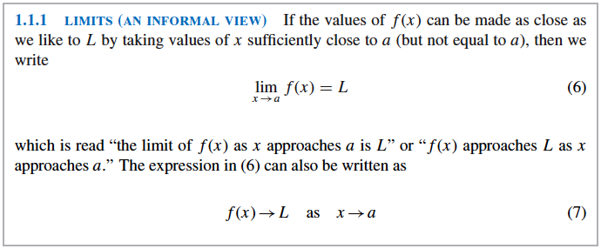

Slide 3
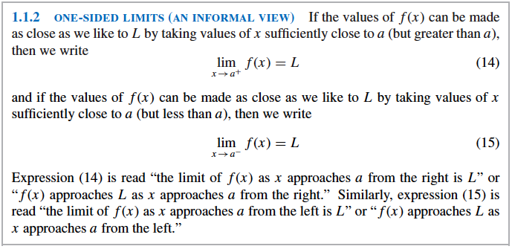

Slide 4
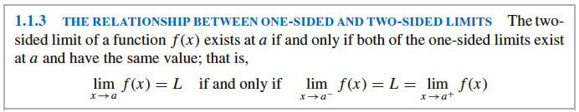

Slide 5
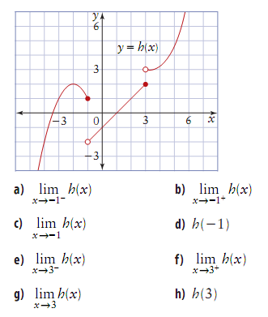

Slide 6
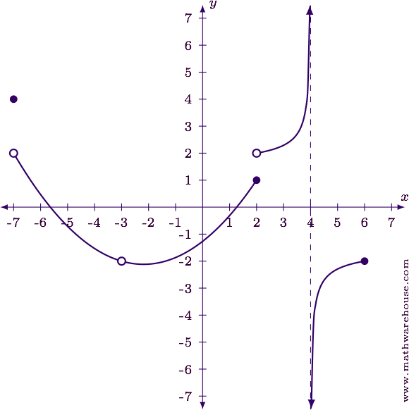
i.$\lim_{x→4}{f\left(x\right) }$ii. $\lim_{x→2}{f\left(x\right) }$iii. $\lim_{x→−3}{f\left(x\right) }$iv. $\lim_{x→−7}{f\left(x\right) }$v. $\lim_{x→6}{f\left(x\right) }$

Slide 7
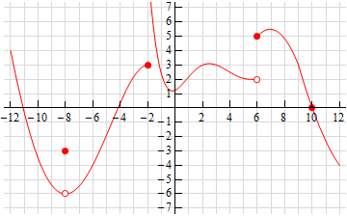
i.$\lim_{x→−8}{f\left(x\right) }$ii. $\lim_{x→−2}{f\left(x\right) }$iii. $\lim_{x→6}{f\left(x\right) }$iv. $\lim_{x→10}{f\left(x\right) }$

Slide 8
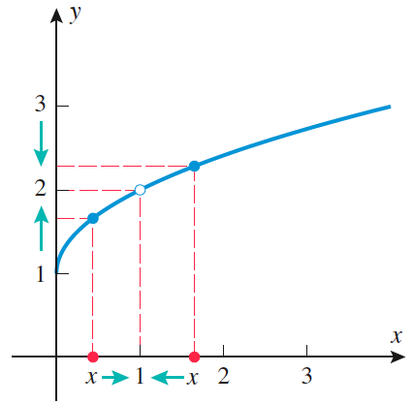
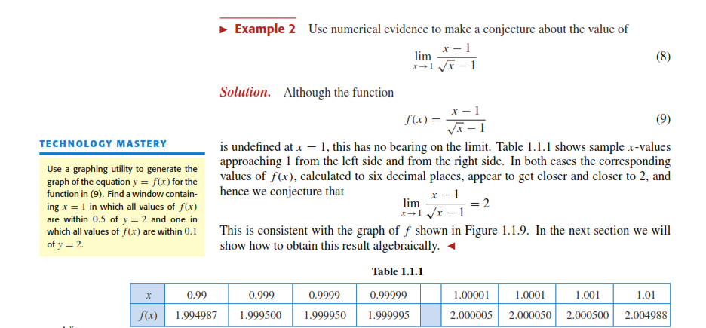

Slide 9
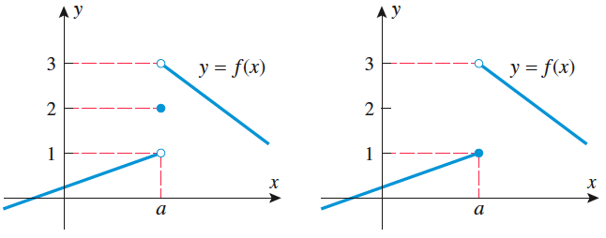
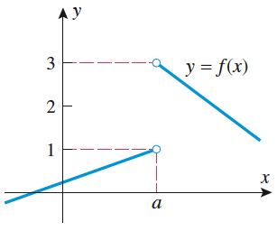
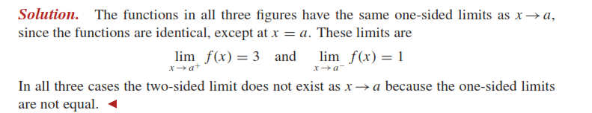

Slide 10
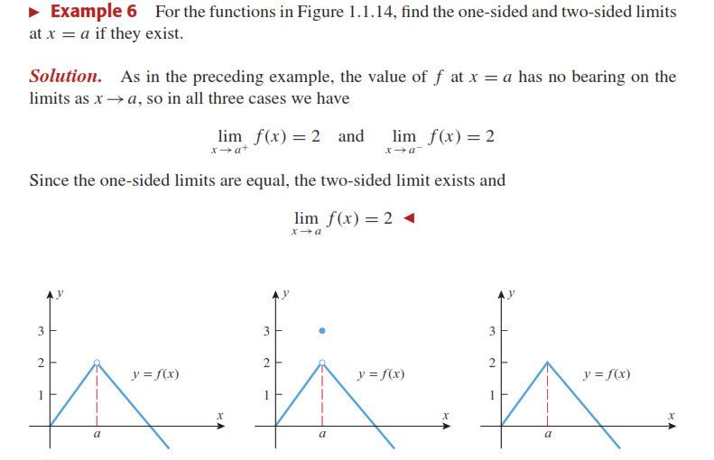

Slide 11
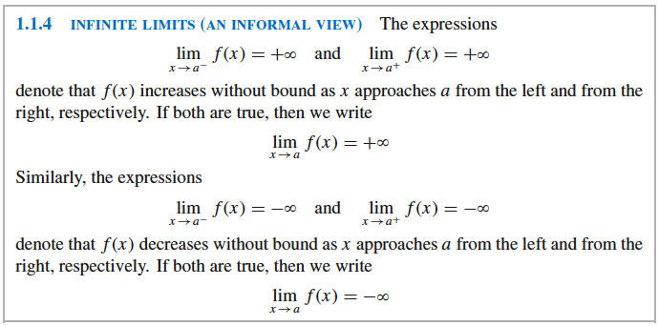

Slide 12
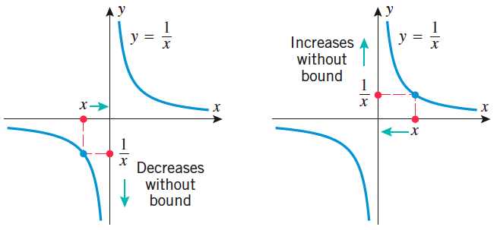
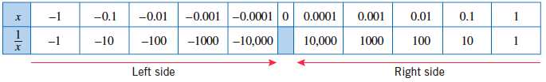

Slide 13
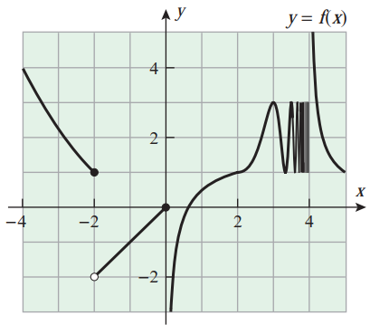
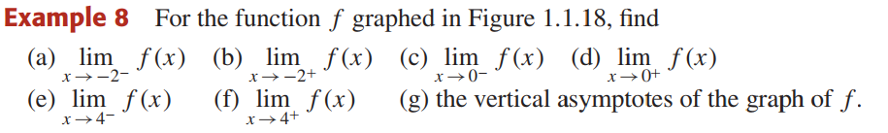

Slide 14


Slide 15


Slide 16
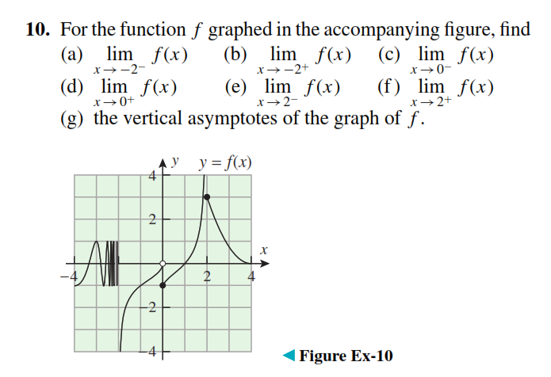
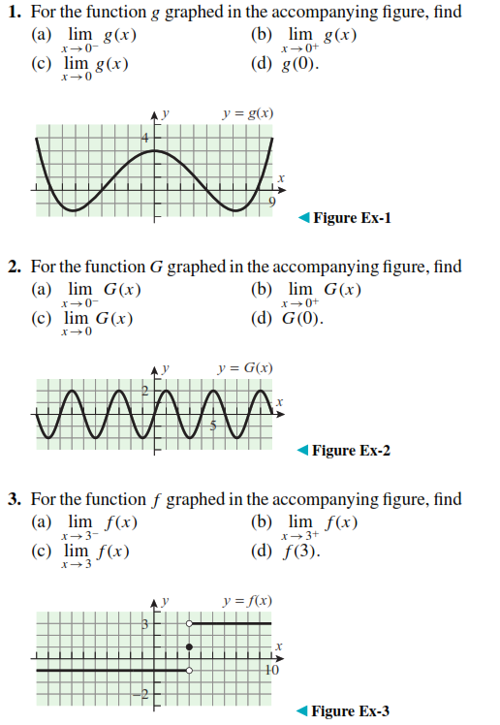

Slide 17
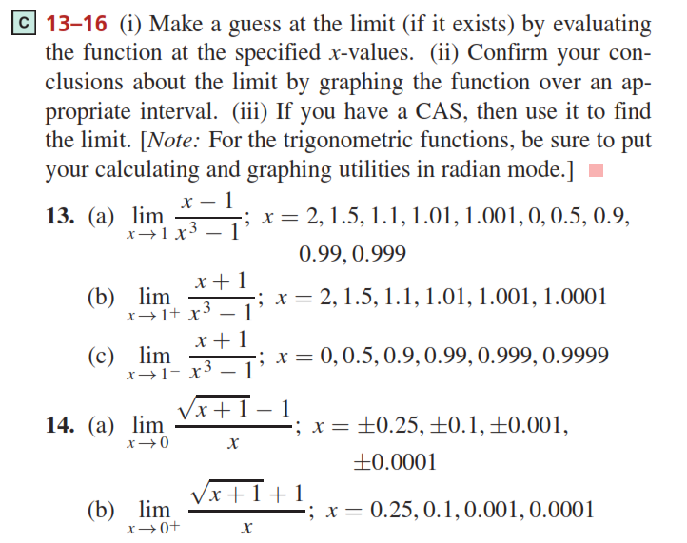

Slide 18
Ex # 1.1
Q # 1-16

Slide 19
Ex# 1.2
More about Limits

Slide 20
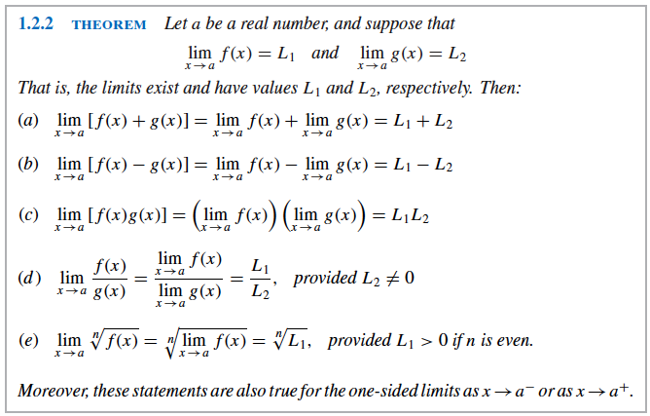

Slide 21


Slide 22
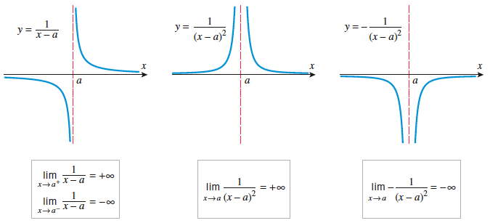

Slide 23
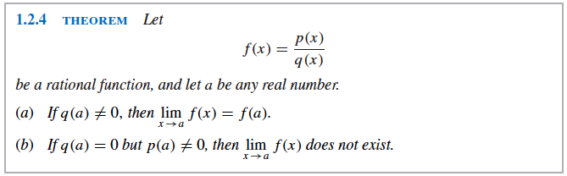

Slide 24

Find the limits..
$\lim_{x→8}{7}$ = 7
$\lim_{x→∞}{(−3)}$= -3
$\lim_{x→0}{π}$ = $π$
$\lim_{y→3}{12y}$ = 12(3) = 36
$\lim_{h→∞}{(−2h)}$ = - ∞
$\lim_{x→5}{\sqrt{x^{3}−3x−1}}$ = $\sqrt{125−15−1}$= $\sqrt{109}$
$\lim_{x→0}{(x^{4}+12x+2)}$ = 0 + 0 + 2 = 2
$\lim_{x→3}{\frac{x^{2} −2x}{x+1}}$ = $\frac{9 −6}{4}$ = $\frac{3}{4}$
$\lim_{y→3}{\frac{(y −1)(y −2)}{y+1}}$ = $\frac{2.1}{4}= \frac{1}{2}$
$\lim_{x→0}{\frac{6x −9}{x^{3} −12 x+3}}$ = $\frac{−9}{3}$ = -3

Slide 25
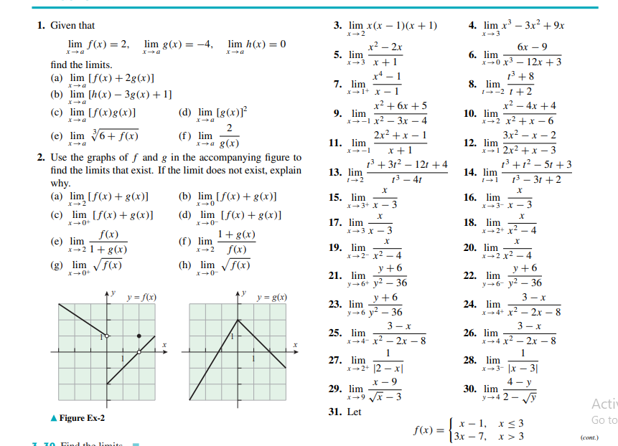

Slide 26
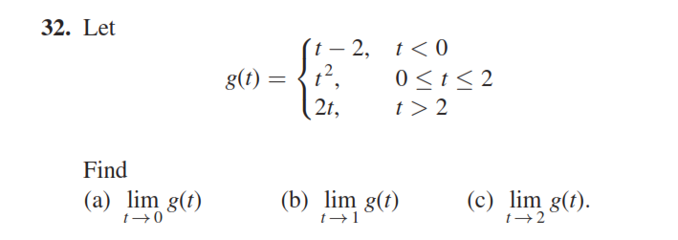

Slide 27
Ex # 1.2
Q # 1-32

Slide 28
Ex# 1.5
Limits & Continuity

Slide 29
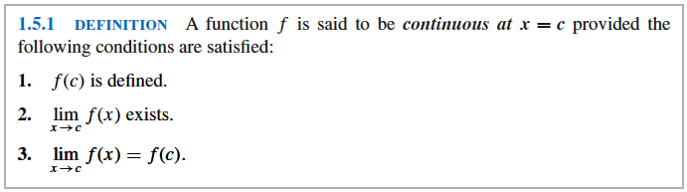

Slide 30
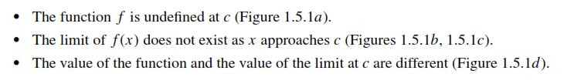
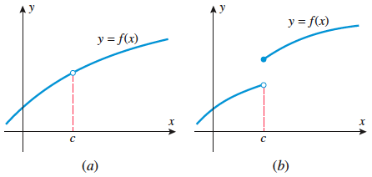
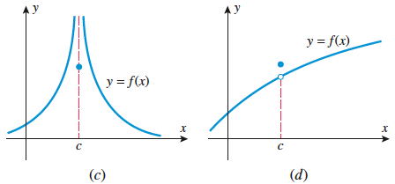
Figure 1.5.1
Infinite discontinuity at c

Slide 31
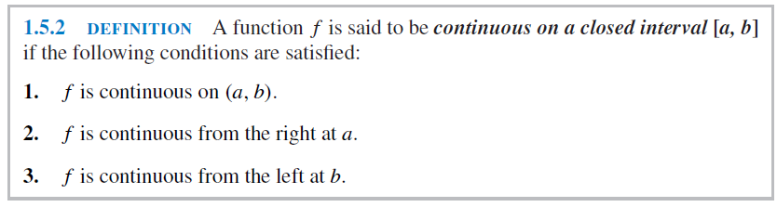

Slide 32
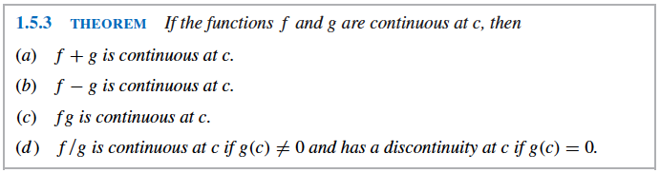

Slide 33
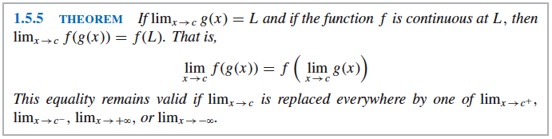

Slide 34
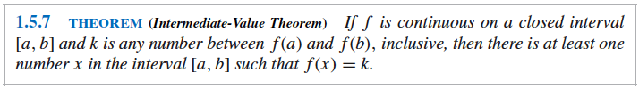
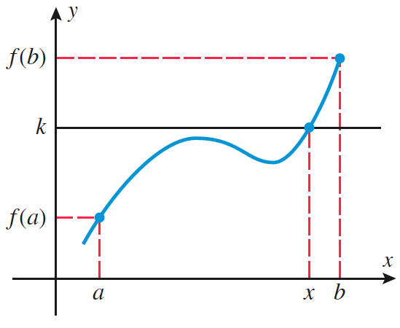

Slide 35

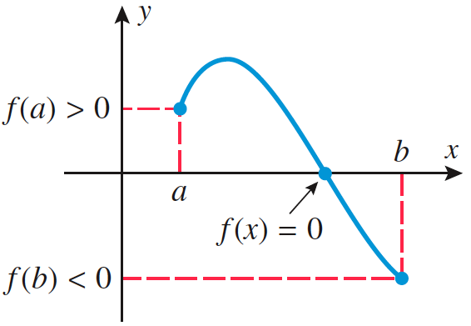

Slide 36
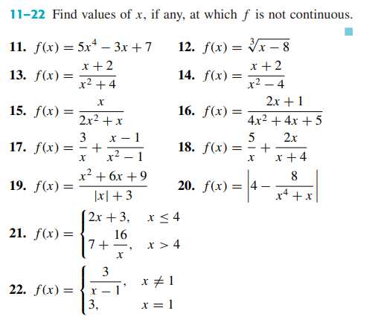
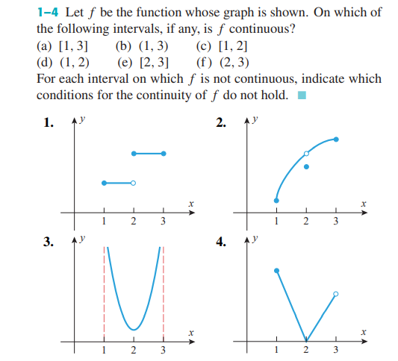

Slide 37
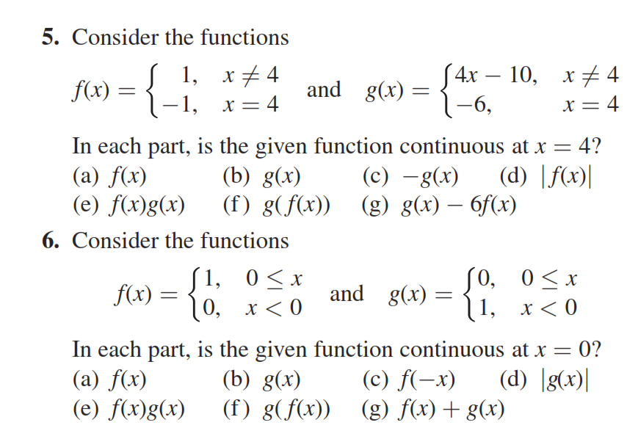

Slide 38
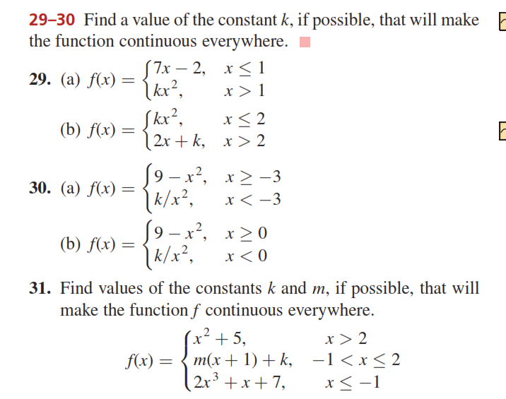

Slide 39
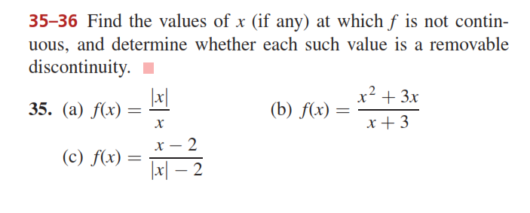
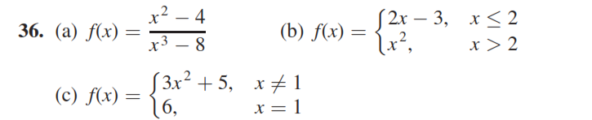

Slide 40
Do Ex # 1.5
Q # 1-6 , 11-22, 29, 30, 35 & 36

